Slide 1
11. COCOMO Model
CSE3203: Software Engineering

Slide 2
Discussion Agenda
Boehm’s Definition of Software Project Types
COCOMO
Basic COCOMO
Estimation of development effort
Estimation of development time
Example practicing

Slide 3
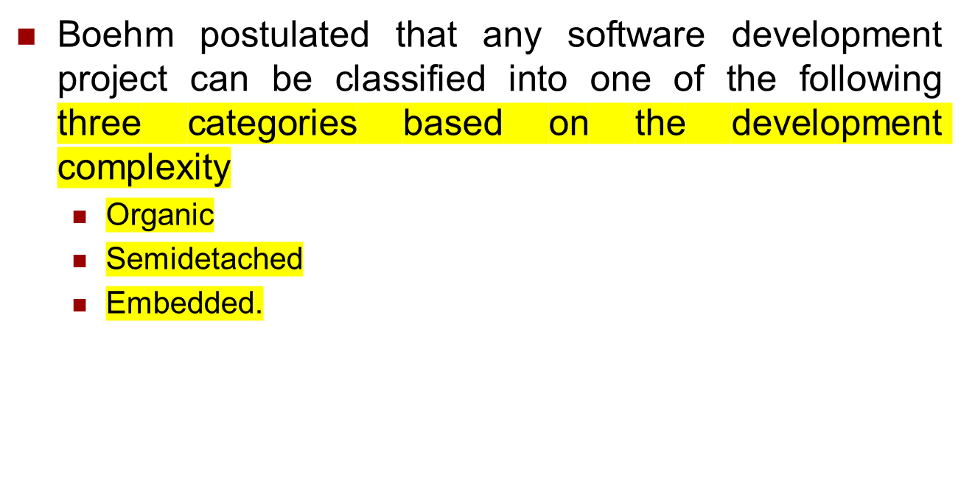
Boehm’s Definition of Software Project Types

Slide 4
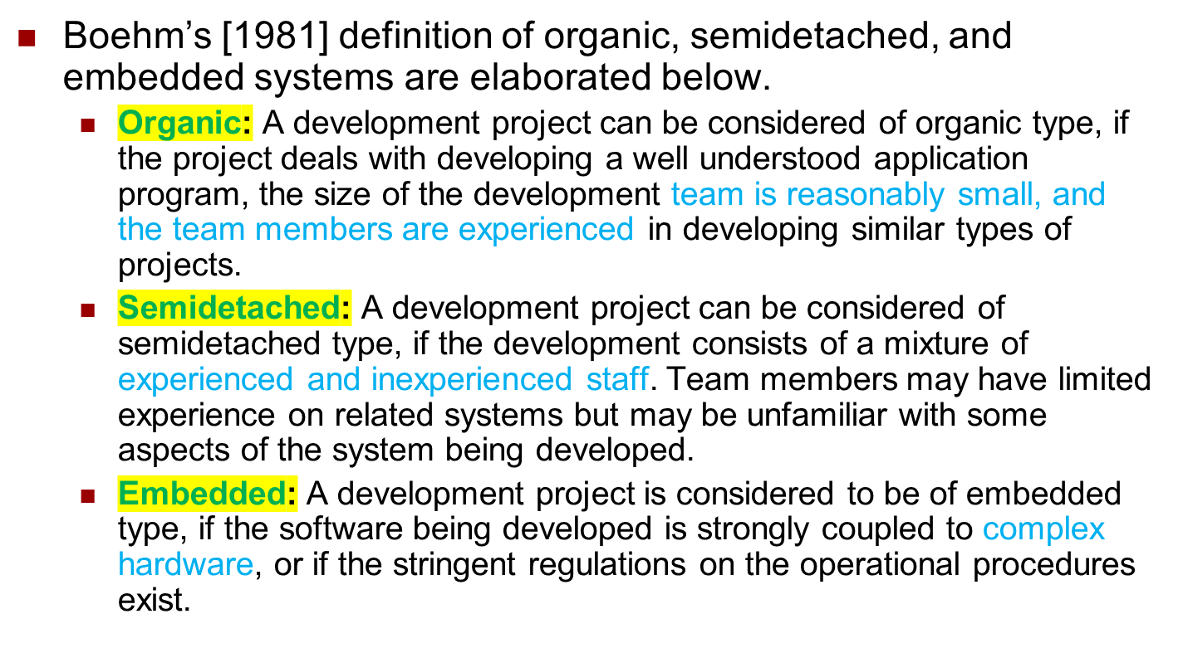
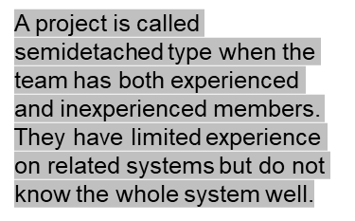
Boehm’s Definition

Slide 5
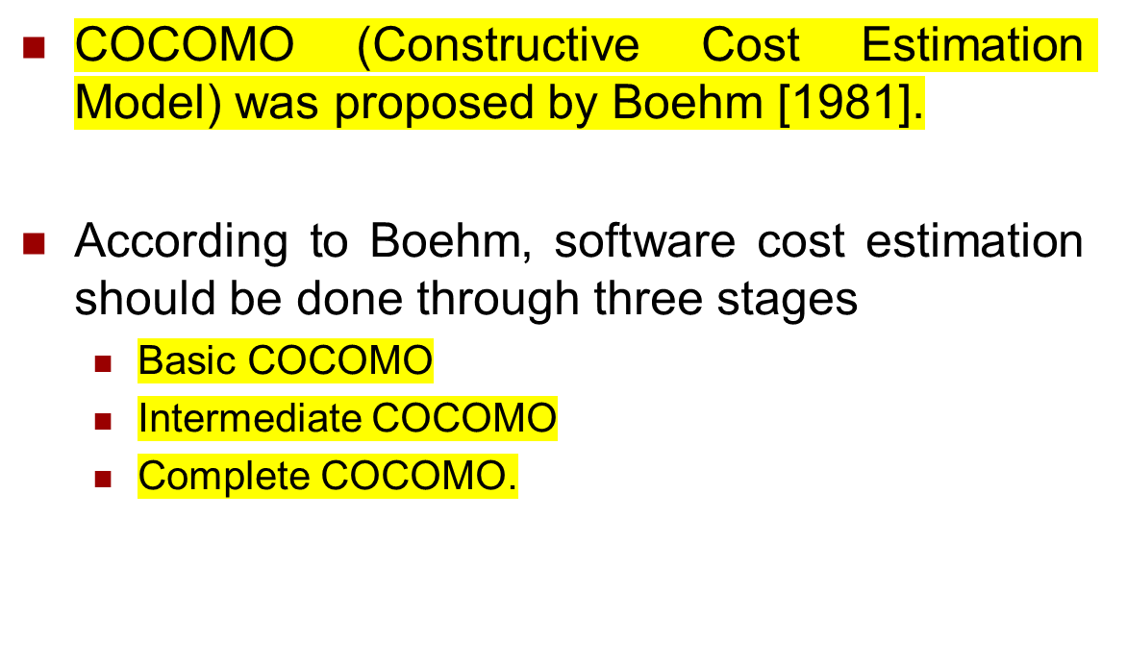
COCOMO

Slide 6
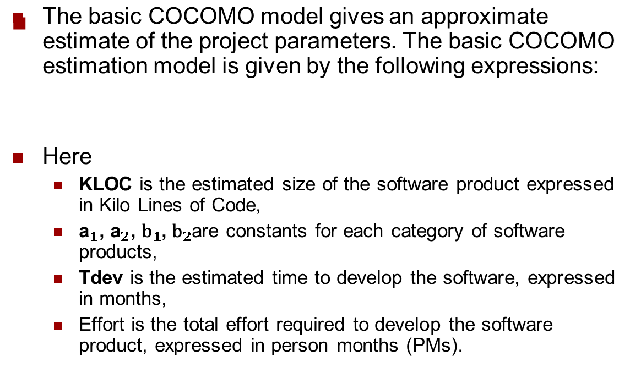


Basic COCOMO

Slide 7


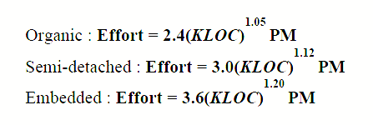


Estimation of Development Effort
For the three classes of software products, the formulas for estimating the effort based on the code size are shown below:

Slide 8


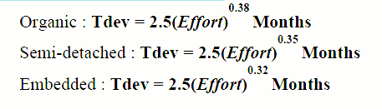
Estimation of Development Time
For the three classes of software products, the formulas for estimating the development time based on the effort are given below:

Slide 9



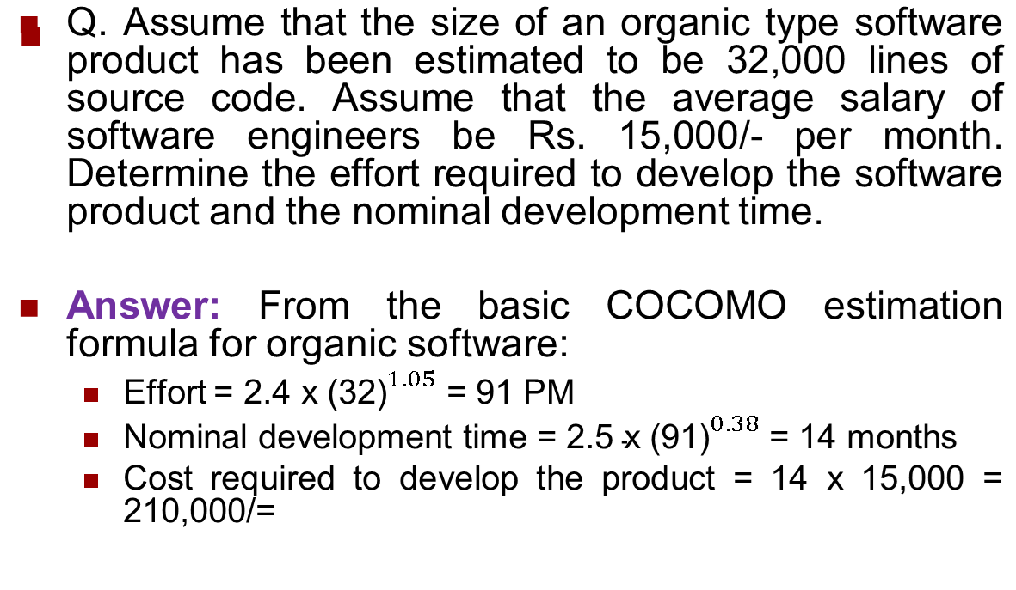
Example

Slide 10
References
  Software Engineering A practitioner’s Approach by Roger S. Pressman, 7th edition, McGraw Hill, 2010.
  COCOMO Model: https://www.educba.com/cocomo-model/
  Software Engineering COCOMO Model: https://www.geeksforgeeks.org/software-engineering-cocomo-model/

